Slide 1
AutoVisionX Hackathon
Dynamic Object Detection for Autonomous Driving

Slide 2
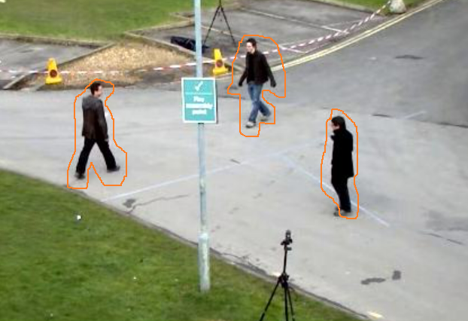
Problem Statement
The challenge is to design and implement a dynamic object detection system to identify and track moving objects in a given environment. The primary application is to enhance autonomous driving capabilities by providing real-time detection of dynamic obstacles in the surroundings. The solution should be implemented in C++ and optimized for the x64 architecture.

Slide 3
Inputs:
Input Video:
A video file that simulates the input from a vehicle's camera system. This video will be used as the input source for dynamic object detection.
Base Address of Memory:
The project should take the start address of memory as a command-line argument. This base address will be used for all memory buffer allocations within the project.
Outputs:
The output of the project should be a processed video with an overlay highlighting the dynamic objects detected in the scene.

Slide 4
Expectations:
C++ Project:
The project should be implemented in C++.
Utilize appropriate libraries or frameworks for image processing and computer vision tasks.
Executable Compatibility:
The executable should be compatible with the x64 architecture.
Command-line Interface:
The project should accept two command-line arguments: the input video file and the base address of memory.
Memory Management:
Efficiently manage memory allocations using the provided base address.
Dynamic Object Detection:
Implement a robust algorithm for dynamic object detection in the video stream.
The detection should include but not be limited to vehicles, pedestrians, and other relevant dynamic objects.
Overlay Output:
The output video should display the original video with an overlay indicating the detected dynamic objects.
Sequence Diagram:
Provide a sequence diagram illustrating the flow of operations in your project.
Include key steps such as video input processing, dynamic object detection, and overlay generation.
Performance Considerations:
Optimize the solution for real-time processing and ensure it is suitable for applications in autonomous driving scenarios.
Documentation:
Include documentation explaining the design choices, algorithms used, and how to build and run the project.
Submission:
Submit a well-commented C++ source code, executable, sequence diagram and documentation.

